Slide 1
Sprint Review
EDA with Lego

Slide 2
Where do I begin?

Slide 3
What are some areas to explore?
Colors
Counts of parts by sets/themes
Patterns over time

Slide 4
How do I get there?
Import all data sets.
Review schema.
Cleaning up column IDs to ensure proper joins.
Plotting anything and everything to visualize patterns.

Slide 5
Experiments: Plot, Plot, Plot
Plot number of parts by year, showing colors by theme.
ggplot(sets, aes(year, inven_parts_quantity, colors = theme_id)) + geom_point()

Slide 6
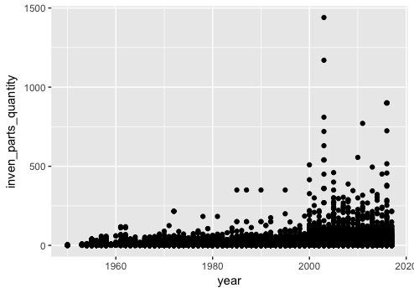
Sum of Parts in Sets Over Time
Observations
The number of parts in sets seems to be growing over time.
The coloring by theme did not work.
Given the size of this data set, it may be too soon to conclude the numbers are growing over time; this might just be showing a few outliers. A mean over time might be additionally useful information.

Slide 7
Tangent: Master Join
Perform a join to start compiling data together. Sets contains year, which should be helpful for visualization. Below is a join for sets and themes using a merge function.
master_join <- merge(sets, inventories, by = "set_num")
master_join <- merge(master_join, inventory_parts, by = "inventory_id")
master_join <- merge(master_join, themes, by = "theme_id")
master_join <- merge(master_join, colors, by = "color_id")
For the future: Need to figure out a function/loop!

Slide 8
Experiments: Plot, Plot, Plot
Plot themes against the number of parts.
ggplot(master_join, aes(theme_id, inven_parts_quantity)) + geom_point()

Slide 9
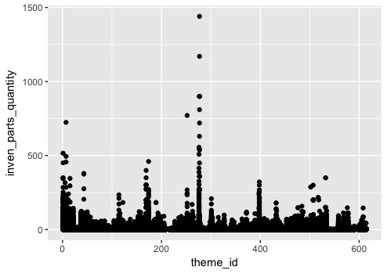
Sum of Parts Plotted Against Theme IDs
Observations
It seems like there might be a semi-regular cadence where there are spikes in the number of parts, but hard to tell if there's anything meaningful here.

Slide 10
Experiments: Plot, Plot, Plot
Plot inventories against number of parts.
ggplot(master_join, aes(inventory_id, inven_parts_quantity)) + geom_point()

Slide 11
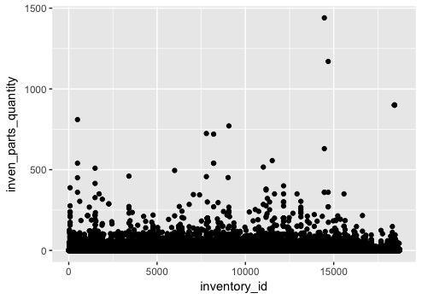
Sum of Parts Against Inventory ID
Observations
No clear pattern here.
From here, I started thinking about looking at maximum/minimums within the set.

Slide 12
Questions that result from this analysis
Which theme has the maximum number of parts, and what is that number?
What color shows up with the highest frequency?
What color has the lowest frequency?

Slide 13
Which theme had the most number of parts?
Aggregate by subgroup and plot. This is asking for a sum of the number of parts for each theme ID beneath a parent ID.
num_parts_by_theme <- aggregate(inven_parts_quantity ~ parent_id + theme_id, data = master_join, sum)
max(num_parts_by_theme$inven_parts_quantity)
RESULT: 69085
subset(num_parts_by_theme, inven_parts_quantity == max(num_parts_by_theme$inven_parts_quantity))
RESULT
parent_id theme_id inven_parts_quantity
22 37 69085

Slide 14
Which theme had the most number of parts? (cont.)
subset(themes, themes$theme_id == 37)
RESULT
parent_id theme_id theme_name
22 37 Basic Set

Slide 15
Colors – Max Frequency
What color shows up with highest frequency?
visual_colors <- count(master_join, "color_name")
ggplot(visual_colors, aes(color_name, freq)) + geom_point()
subset(visual_colors, freq == max(visual_colors$freq))
RESULT
color_name freq
Black 115176

Slide 16
Colors – Min Frequency
What color shows up with lowest frequency?
subset(visual_colors, freq == min(visual_colors$freq))
RESULT
color_name freq
Trans Light Royal Blue 1

Slide 17
What’s next?
Functions/Loops! I did way too many repetitive calls.
Example: Renaming columns and removal via subset.
themes$theme_id <- themes$id themes = subset(themes, select = -c(id) )
part_categories$part_cat_id <- part_categories$id part_categories = subset(part_categories, select = -c(id) )
colors$color_id <- colors$id colors = subset(colors, select = -c(id) )
inventories$inventory_id <- inventories$id inventories = subset(inventories, select = -c(id) )

Slide 18
What’s next?
Research color functions to show groupings within bar graph plots.
Figure out how to minimize the data sets a bit more in order to more easily digest the visual data.

Slide 19
Fin

